Slide 1
项目计划说明汇报
PROJECT PLAN DESCRIPTION REPORT
Fresh business general template
Applicable to enterprise introduction, summary report, sales marketing, chart data
汇报人：G14 汇报时间：2021年3月

Slide 2
目 录
COMPANY
01
02
03
04
05
Introduction
引言
Project Overview
项目概述
Implementation Plan
实施计划
Support Conditions
支持条件
Summary
总结

Slide 3
ONE
引言
Introduction
Fresh business general template
Applicable to enterprise introduction, summary report, sales marketing,

Slide 4

编写目的
Purpose of compilation
此项目计划书的编写目的是为了给开发《社区团购App》做主要的规划和整合，在开发过程中起到引导作用，保证项目团队按时保质地完成项目目标，便于项目团队成员更好地了解项目情况，使项目工作开展的各个过程合理有序，以文件化的形式，把对于在项目生存周期内的工作任务范围、各项工作的任务分解、项目团队组织结构、各团队成员的工作责任、团队内外沟通协作方式、里程碑规划、开发进度、经费预算、项目内外环境条件、风险对策等内容做出的安排以书面的方式，作为项目团队成员以及项目干系人之间的共识与约定，它又是项目生命周期内的所有项目活动的行动基础、项目团队开展和检查项目工作的依据。

Slide 5
项目背景
社区团购是真实居住社区内居民团体的一种互联网线上线下购物消费行为，是依托真实社区的一种区域化、小众化、本地化、网络化的团购形式。社区居民可以通过平台、微信群互动团购 ，平台整合社区订单，开团销售，把相同小区人群的日常所需商品集中配送。配送完成后，社区居民即可主动上门自提。
2020年以来，新冠肺炎疫情改变了人们的消费习惯，社区团购迎来了爆发式增长。目前，瞄准住户周边开展业务的社区团购仍然是一个有待开发的市场。我们小组通过市场分析与用户调研，准备开发一个社区团购App，方便社区居民进行团购。

Slide 6
参考资料
张海藩，牟永敏.软件工程导论(第6版)[M]北京：清华大学出版社.
王硕,曹莉敏,尚民强,方云峰,张巍毅,张铁强.甘特图在大型软件研发项目管理中的应用[J].石油地球物理勘探,2018,53(S1):310-315+19-20.
蔡文,李云,靖婧.WBS在海工项目质量管理中的应用[J].上海质量,2020(07):62-66.
GB/T 8567-2006, 计算机软件文档编制规范[S]
林毅. 基于SWOT工程项目管理软件的应用分析[J]. 电子技术与软件工程, 2016, No.80(06):75-75

Slide 7
标准、条约与约定
GB/T 8567-2006 计算机软件文档编制规范

Slide 8
TWO
项目概述
Project Overview
Fresh business general template
Applicable to enterprise introduction, summary report, sales marketing,

Slide 9
目标
Target
按时按量完成项目的基本功能，按时发布产品及文档
遵循规范化的项目运作标准，文档严谨完整，代码注释充分，便于后续维护
产品运行稳定，界面友好，用户易操作，尽量从用户的角度去看问题，考虑到用户使用的舒适体验感，能够提出解决问题的合理方案
注重团队建设，成员分工合理，团队成员合作默契，气氛融洽。每周会议讨论积极，开发过程中积极协作
项目设计和开发上尽量有创意、存在亮点。

Slide 10
具体过程
1. 准备工作：搭建环境、指定计划书、培训组员
2. 完成需求规格说明书的初稿
3. 系统总体设计
4.系统详细设计
5. 开发系统源代码
6. 系统测试（包含用户实际测试和确认等）
7. 系统交付

Slide 11
工作内容
项目名称：社区团购App
项目用途：便利社区居民进行社区团购。
任务提出者：企业助教
项目开发者：刘书宇、梁泽生、彭昕怡、张安硕、谢子文
用户：社区居民
课程名称：《软件需求分析原理与实践》
承办小组：G14小组
项目里程碑：
具体文档：项目的提出和介绍；软件项目计划；软件可行性分析报告；软件需求分析报告；软件总体设计报告；软件详细设计报告；软件测试报告；项目总结报告。

Slide 12
添加标题
Spring and autumn advertisement
添加标题
添加标题
This template is the spring and autumn advertising original,
This template is the spring and autumn advertising original,
添加标题
添加标题
This template is the spring and autumn advertising original,
This template is the spring and autumn advertising original,

Slide 13
添加标题
Spring and autumn advertisement
标准、条约与约定
GB/T 8567-2006 计算机软件文档编制规范

Slide 14
添加标题
Spring and autumn advertisement
参考资料
张海藩，牟永敏.软件工程导论(第6版)[M]北京：清华大学出版社.
王硕,曹莉敏,尚民强,方云峰,张巍毅,张铁强.甘特图在大型软件研发项目管理中的应用[J].石油地球物理勘探,2018,53(S1):310-315+19-20.
蔡文,李云,靖婧.WBS在海工项目质量管理中的应用[J].上海质量,2020(07):62-66.
GB/T 8567-2006, 计算机软件文档编制规范[S]
林毅. 基于SWOT工程项目管理软件的应用分析[J]. 电子技术与软件工程, 2016, No.80(06):75-75

Slide 15
添加标题
Spring and autumn advertisement
This template is the spring and autumn advertising original, here you can directly modify the content. This template is the spring and autumn advertising original, here you can directly modify the content.
项目背景

Slide 16
添加标题
Spring and autumn advertisement
添加标题
添加标题
This template is the spring and autumn advertising original, here you can directly modify the content.
This template is the spring and autumn advertising original, here you can directly modify the content.
添加标题
添加标题
This template is the spring and autumn advertising original, here you can directly modify the content.
This template is the spring and autumn advertising original, here you can directly modify the content.

Slide 17
添加标题
Spring and autumn advertisement
95%
79%
68%
47%
添加标题
添加标题
添加标题
添加标题

Slide 18
添加标题
Spring and autumn advertisement
添加标题
添加标题
This template is the spring and autumn advertising original, here you can directly modify the content.
This template is the spring and autumn advertising original, here you can directly modify the content.
添加标题
添加标题
This template is the spring and autumn advertising original, here you can directly modify the content.
This template is the spring and autumn advertising original, here you can directly modify the content.

Slide 19
添加标题
Spring and autumn advertisement
标题
This template is the spring and autumn advertising original, here you can directly modify the content. This template is the spring and autumn advertising original, here you can directly modify the content.
标题
This template is the spring and autumn advertising original, here you can directly modify the content. This template is the spring and autumn advertising original, here you can directly modify the content.
标题
This template is the spring and autumn advertising original, here you can directly modify the content. This template is the spring and autumn advertising original, here you can directly modify the content.

Slide 20
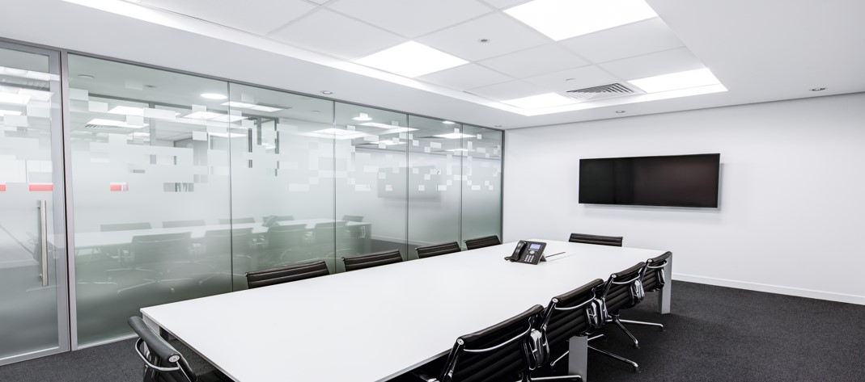
添加标题
Spring and autumn advertisement
添加标题
This template is the spring and autumn advertising original, here you can directly modify the content.
This template is the spring and autumn advertising original, here you can directly modify the content. This template is the spring and autumn advertising original, here you can directly modify the content. This template is the spring and autumn advertising original, here you can directly modify the content. This template is the spring and autumn advertising original, here you can directly modify the content.

Slide 21
添加标题
Spring and autumn advertisement
添加标题
添加标题
This template is the spring and autumn advertising original,
This template is the spring and autumn advertising original,
添加标题
添加标题
This template is the spring and autumn advertising original,
This template is the spring and autumn advertising original,

Slide 22
THREE
请在此添加标题
Please add the title here
Fresh business general template
Applicable to enterprise introduction, summary report, sales marketing,

Slide 23
添加标题
Spring and autumn advertisement
01
02
03
添加标题
添加标题
添加标题
This template is the spring and autumn advertising original,
This template is the spring and autumn advertising original,
This template is the spring and autumn advertising original,
85%
75%
99%

Slide 24
添加标题
Spring and autumn advertisement
This template is the spring and autumn advertising original, here you can directly modify the content. This template is the spring and autumn advertising original, here you can directly modify the content.
This template is the spring and autumn advertising original, here you can directly modify the content. This template is the spring and autumn advertising original, here you can directly modify the content.
This template is the spring and autumn advertising original, here you can directly modify the content. This template is the spring and autumn advertising original, here you can directly modify the content.
This template is the spring and autumn advertising original, here you can directly modify the content. This template is the spring and autumn advertising original, here you can directly modify the content.

Slide 25

添加标题
Spring and autumn advertisement
This template is the spring and autumn advertising original, here you can directly modify the content.
This template is the spring and autumn advertising original, here you can directly modify the content.
This template is the spring and autumn advertising original, here you can directly modify the content.
This template is the spring and autumn advertising original, here you can directly modify the content.

Slide 26
FOUR
请在此添加标题
Please add the title here
Fresh business general template
Applicable to enterprise introduction, summary report, sales marketing,

Slide 27
添加标题
Spring and autumn advertisement
This template is the spring and autumn advertising original, here you can directly modify the content.
This template is the spring and autumn advertising original, here you can directly modify the content.
This template is the spring and autumn advertising original, here you can directly modify the content.
This template is the spring and autumn advertising original, here you can directly modify the content.
添加标题
添加标题
添加标题
添加标题

Slide 28
谢谢观看
汇报人：优品PPT 汇报时间：XX年XX月

Slide 29
更多精品PPT资源尽在—优品PPT！
www.ypppt.com
PPT模板下载：www.ypppt.com/moban/ 节日PPT模板：www.ypppt.com/jieri/
PPT背景图片：www.ypppt.com/beijing/ PPT图表下载：www.ypppt.com/tubiao/
PPT素材下载： www.ypppt.com/sucai/ PPT教程下载：www.ypppt.com/jiaocheng/
字体下载：http://www.ypppt.com/ziti/ 绘本故事PPT：http://www.ypppt.com/gushi/
Notes:
模板来自于 http://www.ypppt.com

